Slide 1
M&E Systems Assessment
Applying the M&E System Strengthening Tool

Slide 2
Learning Objectives
Understand M&E best practice standards
Describe 12 components of an M&E System
Assess the M&E Systems Strengthening Tool

Slide 3
Session Overview
Review M&E best practices
12 Components of a fully functional M&E system
Introduce M&E Systems Strengthening Tool
Activity: Implementing the Tool

Slide 4
M&E Best Practices – Three Ones^{1,2}
Introduced in 2004
One agreed HIV/AIDS action framework
Rationale for exceptional AIDS action
One National AIDS Coordinating Authority
National ownership: who is included
One agreed country level M&E System
Accountability: who is accountable to whom
Weakest of the 3 Ones
¹UNAIDS. 2004. “Three Ones” key principals. Conference paper 1, Washington consultation 25-04-04
²UNAIDS. 2004. Clearing the common ground for the “Three Ones”. Conference paper 2, Washington consultation 25-04-04

Slide 5
Three Ones applicable to any level of M&E system¹
Level | One M&E System
International | UNGASS reporting every 2 years
National | One M&E system
Sub-national | District level M&E systems feeding into national system
Project | Project level M&E systems feeding into regional/national system
Source: Binagwaho and Gorgens, 2007
¹Marelize Gorgens-Albino, The World Bank Global AIDS M&E Team (GAMET)

Slide 6
One agreed National M&E Framework^{1,2}
Multiple systems exist; no functional “best practice” model yet accepted
Result: hampered M&E efforts & low data quality
Global level harmonization needed
Agreement among global partners on reporting protocols
Core national system linked to M&E Framework (NAC leadership)
Monitor progress towards controlling epidemic
Agreed strategies for data quality
Assess existing M&E systems, consensus on improvement, increase data quality
Investment in national capacity
Building human capacity to meet national M&E needs
¹UNAIDS. 2004. “Three Ones” key principals. Conference paper 1, Washington consultation 25-04-04;
²UNAIDS.
2004. Clearing the common ground for the “Three Ones”. Conference paper 2, Washington consultation 25-04-04

Slide 7
Common M&E Framework: Country/Donor Basic Information Needs¹
What is happening with the epidemic?
Can people protect themselves/others from transmission?
Knowledge, skills, available interventions & their impact
Are infected people receiving quality treatment?
Monitoring adherence and quality of care
Are affected families receiving services, especially OVCs?
Are pregnant women using services to reduce MTCT?
Are resources being spent in right places for most effective activities to reach set targets?
What is impact on health/other social sectors as result of epidemic and response?
¹UNAIDS. 2004. Clearing the common ground for the “Three Ones”. Conference paper 2, Washington consultation 25-04-04

Slide 8
12 Components Framework
An organizing framework
Map all aspects of the HIV M&E system to the 12 components
All partners, including UNAIDS, USG, the GFATM & others have agreed on the 12 components as an organizing framework

Slide 9
12 Components of an M&E System¹
GAMET* defined 11 components of a fully functional HIV M&E System, went to 12
Goals of a national HIV M&E System
Track the epidemic
Track drivers of the epidemic
Track effectiveness & efficiency of response (results of services/interventions)
Determine extent of response (who is doing what, where)
¹Görgens-Albino, Marelize & Masauso Nzima. 2006. Eleven components of a fully functional HIV M&E system. HIV/AIDS M&E – Getting Results Report series. *Global AIDS Monitoring and Evaluation TEAM (GAMET), CDC.

Slide 10
12 Components of an M&E System

Slide 11
M&E Systems Strengthening Tool

Slide 12
The Monitoring & Evaluation Systems Strengthening Tool¹
A new approach to M&E Assessments
FROM …
TO …
GF-centric
Exclusively conducted by LFAs
Country-driven
Self-assessment by the PR with relevant partners
Focused exclusively on PR capacities
Expanded to integration in the wider M&E Systems
General approach
Based on open-ended questions
More systematic/thorough approach
Based on a checklist of items
Strictly assessment tool
Broader assessment, management and planning tool
¹http://www.theglobalfund.org/en/performance/monitoring_evaluation

Slide 13
M&ESS Tool: Harmonized tool jointly developed
The tool has been developed under a joint initiative from:
The Global Fund
The Measure EVALUATION Project
PEPFAR
USAID
WHO
The Health Metrics Network (HMN)
Other Partners have joined this initiative, including:
RBM
UNAIDS
World Bank
Stop TB
UNICEF

Slide 14
Expected Benefits from M&ESS Tool
Guide strategic investments in M&E for grant signature or in existing grants (within the recommended range of 5%-10% of the overall grant budget)
Better identify M&E capacity gaps and corresponding strengthening measures, including through Technical Support
Ensure that investments in M&E are based on identified weaknesses and contribute to the strengthening of the National Systems (avoiding parallel reporting systems)
Enhance the quality of programmatic data to improve program management and to support Performance-based Funding

Slide 15
The M&ESS Tool Assesses 3 Areas (all 12 components:
M&E Strengthening Tool
Purpose
1- M&E Plan
To assess the strength of the Monitoring and Evaluation (M&E) Plan.
2- Data-management capacities of the Management Unit
To assess the capabilities of the Management Unit (PR) to manage data related to the implementation of the Grants.
To assess the strengths of the data-collection and reporting systems per Program Area, including the ability to report valid, accurate and high quality data related to implementation.
3- Data-collection and reporting systems per Program Area (e.g., ARV, PMTCT)

Slide 16
Assessment of Program Capacity to Collect, Analyze, Use and Report reliable M&E data
PART 1: M&E Plan
PART 2: Data-management Capacities of Program
Systems for Reporting Numbers of:
1- People Reached
2- Commodities Distributed
3- Individual Trained
4- Service Points Supported
PART 3: Program Area 1
PART 3: Program Area 2
PART 3: Program Area 3
PART 3: Program Area 4
ARV
PMTCT
Condoms
OVC

Slide 17
How does the M&ESS Tool Work?
Step 1: Diagnosis
Step 2: Action Plan
Diagnosis by completing checklist:
Answers to Statements/Questions.
Provision of Comments/Explanations
Development of costed action plan:
ID Strengths and Weaknesses
Def. Strengthening Measures
Responsibility
Timeline
Funding Implication
Technical support needs

Slide 18
Step 1: Diagnosis
List of Statements
(what should be in place)
5 Categories
- Yes-Completely
- Mostly
- Partly
- No- Not at All
Comments
(if answer not Yes )
Review and Verification (to be filled out by the org. reviewing the completed tool)

Slide 19
Step 2: Analysis
ASSESSMENT OF HEALTH FACILITY-BASED REPORTING SYSTEM -
Distribution of Answer Categories
People Reached
6
4
3
3
0
Systems for Reporting on Numbers of
Commodities Distributed
1
3
1
1
0
Systems for Reporting on Numbers of
based Interventions
3
2
3
1
0
Systems for Reporting on Numbers of
Individuals Trained for Health Facility-
3
1
0
0
Service Points Supported
0
Systems for Reporting on Numbers of
OVERALL
13
10
7
5
0
0%
10%
20%
30%
40%
50%
60%
70%
80%
90%
100%

Slide 20
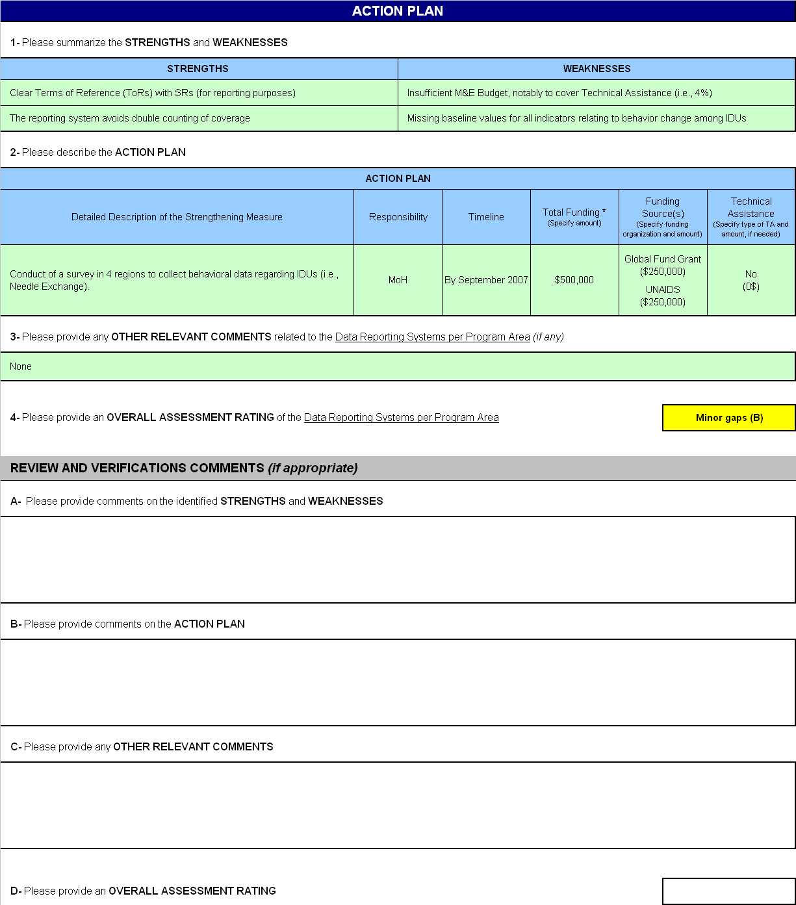
Step 3: Action Plan
Strengths & Weaknesses
Costed Action Plan & list Strengthening Measures
(Responsibility, Funding & Timeline)
Other Relevant Comments
Assessment Rating
(A-No gaps, B- Minor gaps, C-Major gaps)
Review and Verification (to be filled out by the organization reviewing the completed tool)

Slide 21
Components of the M&ESS Tool: M&E Plan
National strategy and national M&E plan
Does it exist?
Program goals and objectives
In line with national strategy? Measurable & time-bound?
M&E Indicators
Clearly defined, specified data sources & targets
Linked to national system?
Selected in concert with national/international guidelines?
Data dissemination & transparency
Data shared effectively?
Sensitive data remain confidential?
M&E budget
Sufficient funds for M&E?

Slide 22
Components of the M&ESS Tool: Data Management Capacities
Management Unit inputs for success
Resources, procedures, skills, experience
Feedback provided to reporting entities on quality of reports & performance
Oversight of sub-reporting entity
Sufficient guidance & support?
Reports submitted on time & error free?

Slide 23
Components of the M&ESS Tool: Program area data reporting systems
Numbers of people reached
Data collection & reporting lead to quality data on numbers reached by the program?
Numbers of commodities distributed
Data collection & reporting lead to quality data on numbers of commodities supplied by the program?
Numbers of people trained
Data collection & reporting lead to quality data on numbers of people trained by the program?
Numbers of service points supported
Data collection & reporting lead to quality data on numbers of service points/facilities supported by the program?

Slide 24
M&ESS Tool Implementation
Stakeholder’s workshop
Consensus among program implementers, donors and government players
Promoting alignment and harmonization at country level
Enable leverage of technical expertise
Allow pooling of funding & id of shared initiatives
Relevant stakeholders – those that can provide technical input or have major investment in the country

Slide 25
The M&ESS Tool Workshop
Organization
GFATM: CCM
Others: Program overseers, whoever can gather stakeholders
Duration – 1-3 days
Participation
Program implementers, donors, managers, data collectors and users
Participants read and fill out tools before workshop*
Facilitation
M&E expert, a trusted party
Funding
Various
*This is the ideal; reading the Tool at a minimum

Slide 26
Outputs – Agreed Costed Plan
Addresses strengths and weaknesses of M&E system
Identifies needs for technical support
Identifies funding needs and sources for described gaps
Builds consensus, strengthens “Third One”
Specifically
Revision of M&E Plan, budget and workplan

Slide 27
Activity
Implementing the Tool & developing an action plan

Slide 28
MEASURE Evaluation is a MEASURE project funded by the
U.S. Agency for International Development and implemented by
the Carolina Population Center at the University of North Carolina
at Chapel Hill in partnership with Futures Group International,
ICF Macro, John Snow, Inc., Management Sciences for Health,
and Tulane University. Views expressed in this presentation do not
necessarily reflect the views of USAID or the U.S. Government.
MEASURE Evaluation is the USAID Global Health Bureau's
primary vehicle for supporting improvements in monitoring and
evaluation in population, health and nutrition worldwide.

